Slide 1
Wireshark-Based Network Traffic Investigation
PCAP analysis report: baseline capture SBT-PCAP1
B. Jaya Vardhan and Bhagya Sree

Slide 2
Scenario and method
A user reported unusual network activity, and two lab captures were provided. This report covers SBT-PCAP1.
Communication was rebuilt from packet evidence only, using Wireshark statistics views, display filters and Follow TCP Stream.
Every finding cites a Wireshark frame number (the No. column).
Tasks covered: ip conversations, protocols and ports, ARP and DNS, the TCP handshake, a TCP stream, and unusual items.

Slide 3
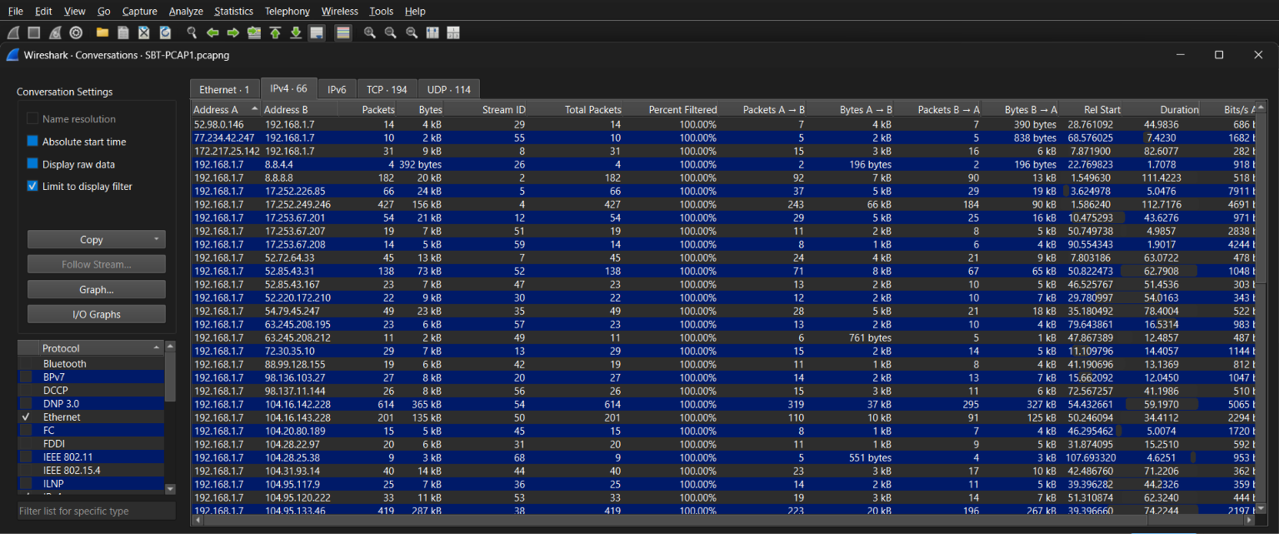
Who is talking to whom
IPv4 Conversations table, filtered on the client IP
The IPv4 Conversations table gives Address A, Address B, packet count and bytes transferred for each pair.
Result: the client 192.168.1.7 is talking to remote IP 17.252.226.85.

Slide 4
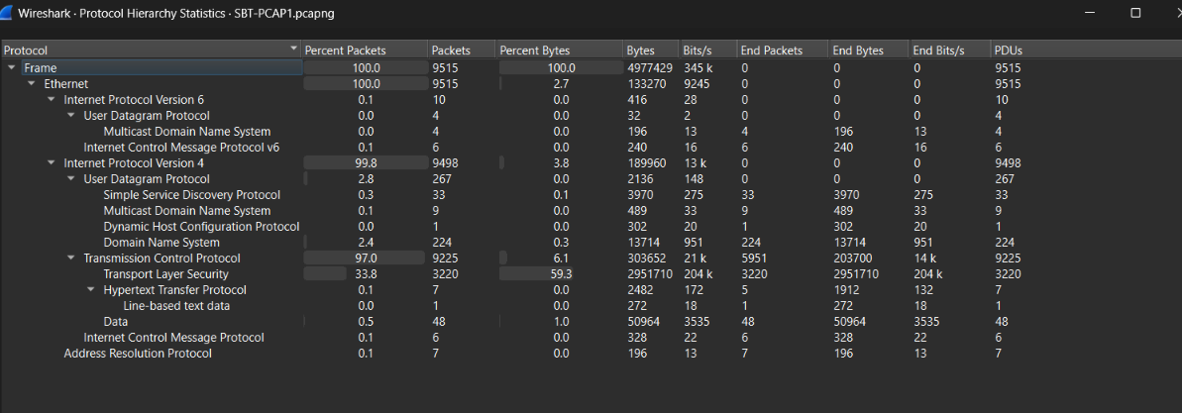
Protocols in the capture
9,225
3,220
224
7 / 6
TCP packets
TLS packets
UDP and DNS
HTTP / ICMP
Protocol Hierarchy Statistics show mostly TCP, and mostly encrypted TLS.

Slide 5
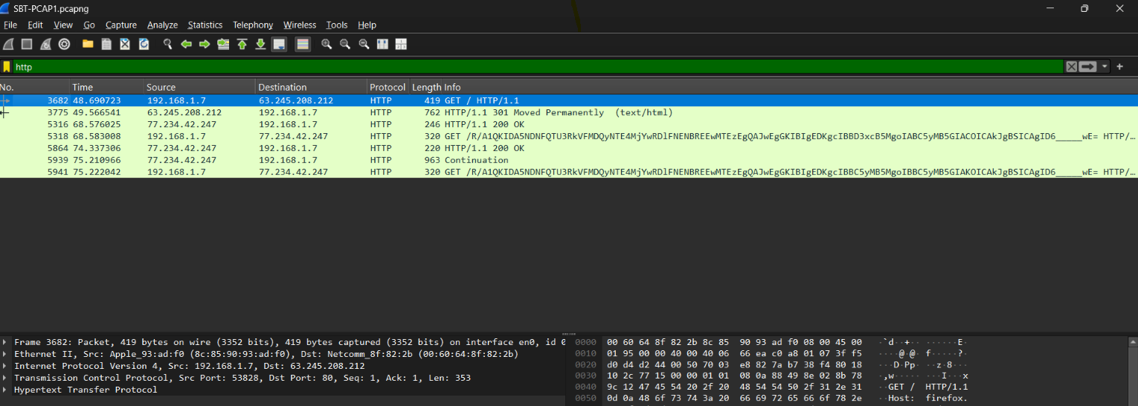
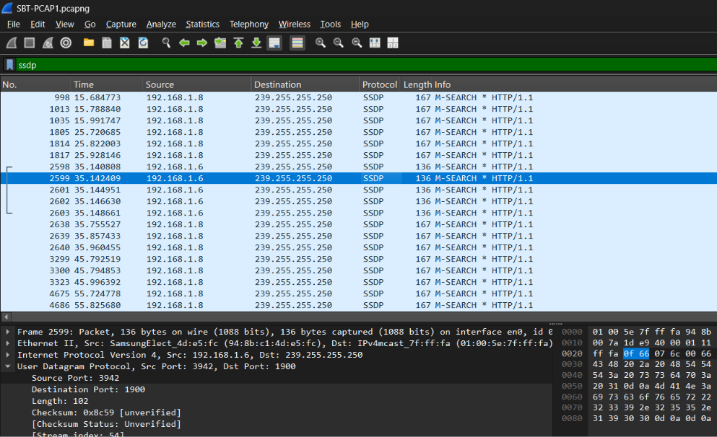
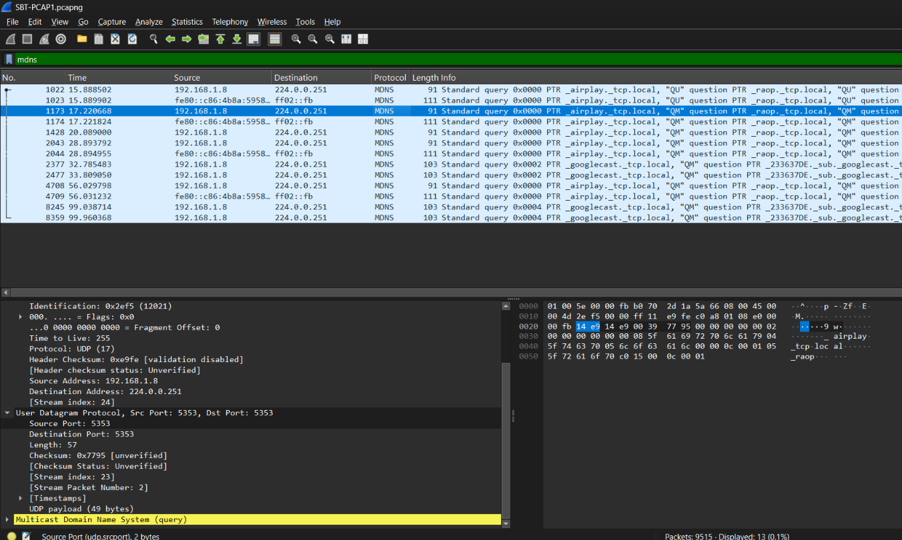
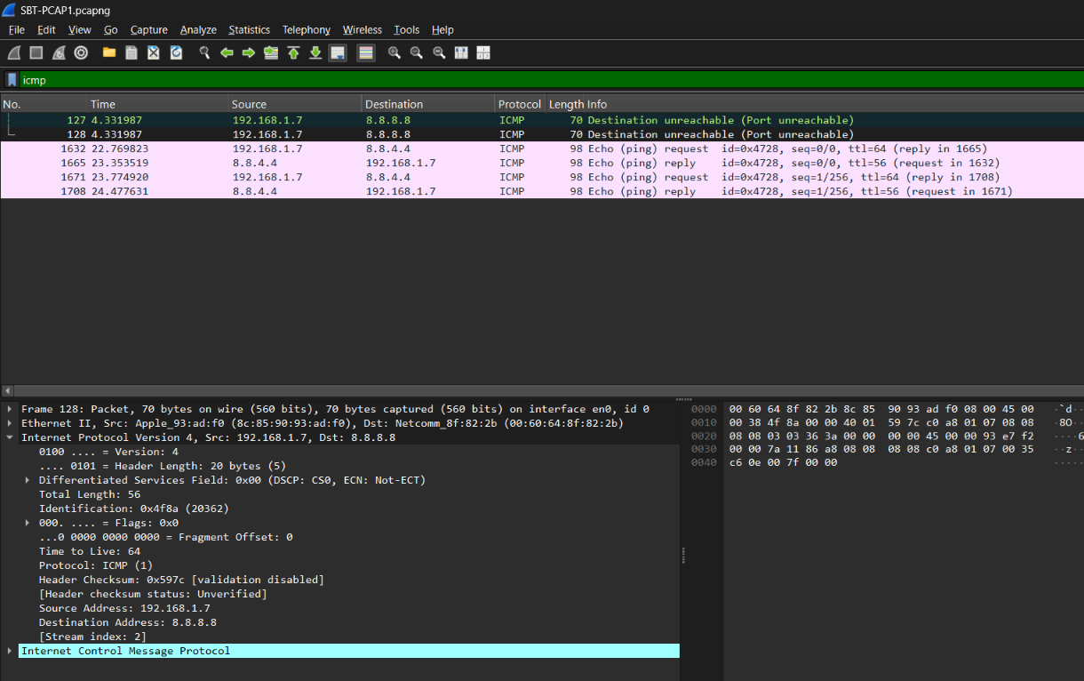
Ports in use
Port 80 (HTTP)
UDP 1900 (SSDP)
Client source port 53828 to server port 80, the standard HTTP port.
Source port 3942 to destination 1900, the standard SSDP port.
UDP 5353 (mDNS)
ICMP
Same port at both ends, so every device hears the response.
No TCP or UDP ports: ICMP works at the network layer.

Slide 6
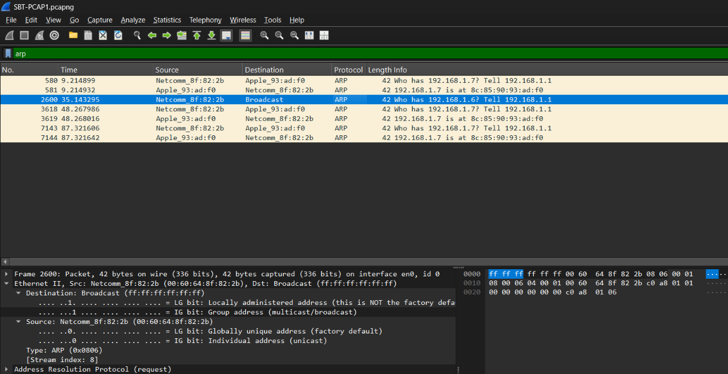
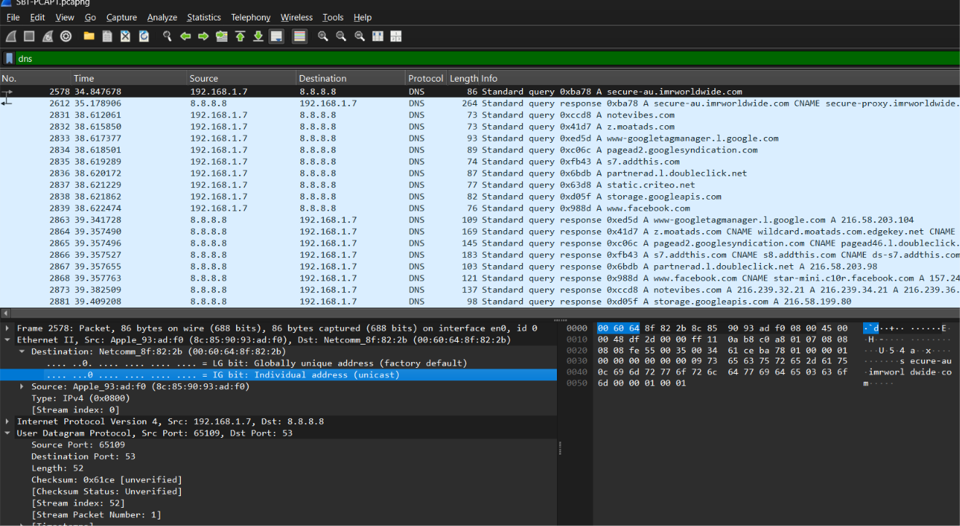
ARP and DNS
ARP: normal cache refresh
DNS: queries to 8.8.8.8
The gateway asks "Who has 192.168.1.7?" in frames 580, 3618 and 7143. The client answers each time with MAC 8c:85:90:93:ad:f0. The gateway also asks for 192.168.1.6 in frame 2600, resolving another local device.
Queries go from client 192.168.1.7 to 8.8.8.8 over UDP port 53, and responses come back from 8.8.8.8.

Slide 7
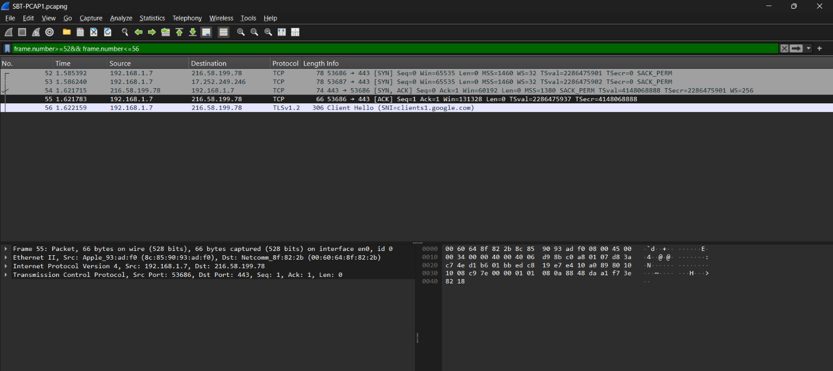
The TCP three-way handshake
Frames 52, 54, 55: 192.168.1.7:53686 to 216.58.199.78:443 (TLS to Google)
SYN
SYN, ACK
ACK
Frame 52 · t = 1.586 s
→
Frame 54
→
Frame 55
Seq=3989314022
Seq=3826294920
Ack=3989314023
Client confirms; the connection is open
Plain-HTTP example: stream of frame 3682 (port 53828). SYN frame 3574 (47.87 s), SYN-ACK frame 3679 (48.69 s), ACK frame 3680. The 0.8 s wait for the SYN-ACK is a slow handshake.

Slide 8
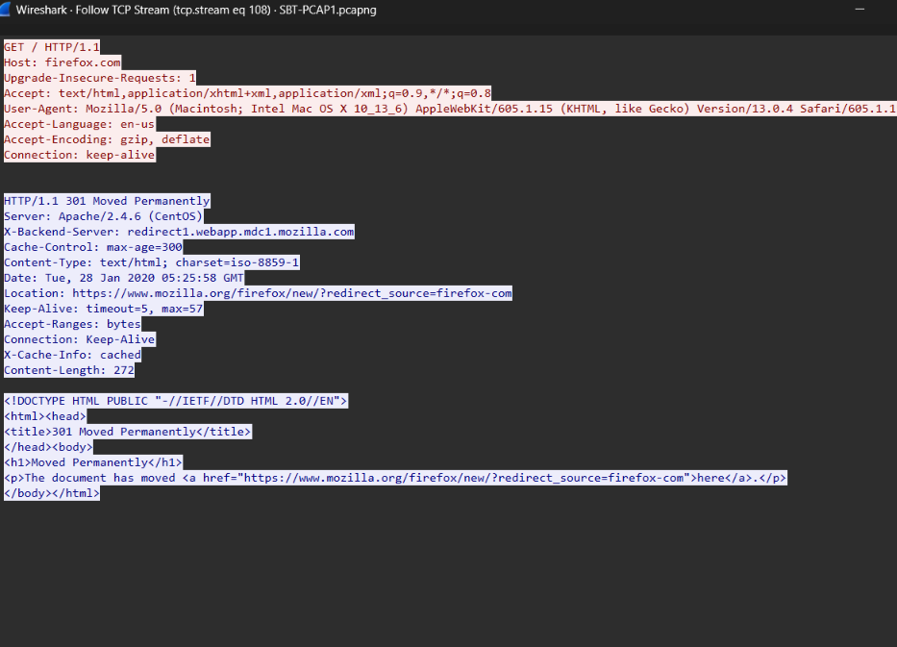
Follow TCP Stream: HTTP
GET
HTTP request to firefox.com
301
Moved Permanently, redirecting to https://www.mozilla.org/firefox/new/
Apache 2.4.6
Server software, running on CentOS

Slide 9
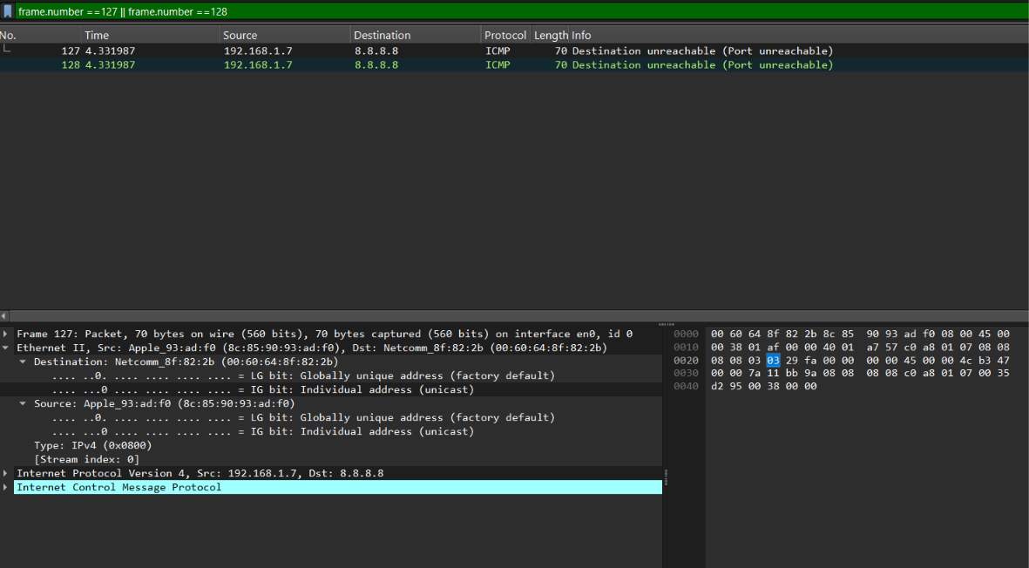
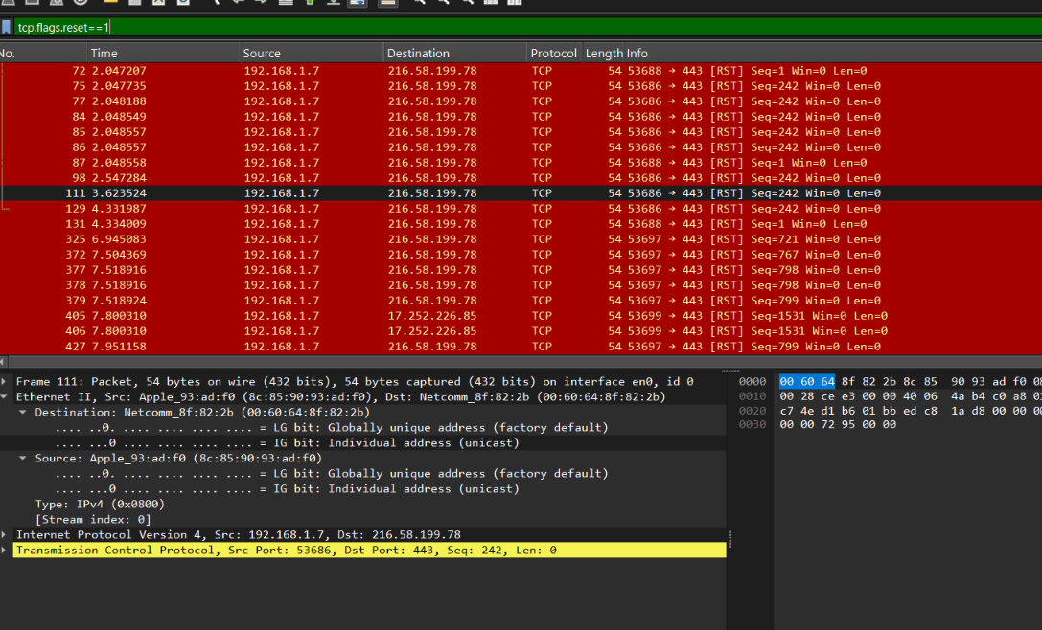
Unusual items: ICMP and TCP resets
ICMP port unreachable (frames 127, 128)
TCP resets
frame.number ==127 || frame.number ==128
tcp.flags.reset==1
The client sent traffic toward 8.8.8.8, but the destination port was not listening, so an ICMP Destination Unreachable (Port Unreachable) came back.
The RST count is high, but it is mostly HTTPS on port 443 with no port-scan or flood pattern. Treated as benign connection termination.

Slide 10
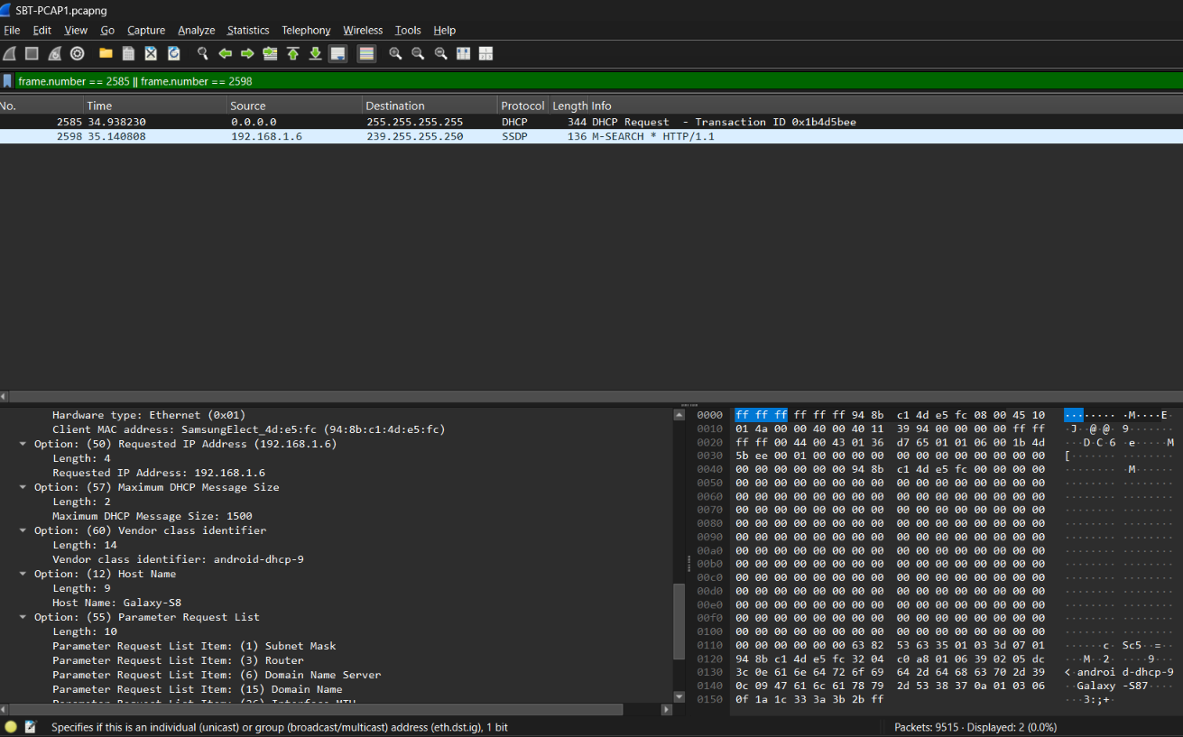
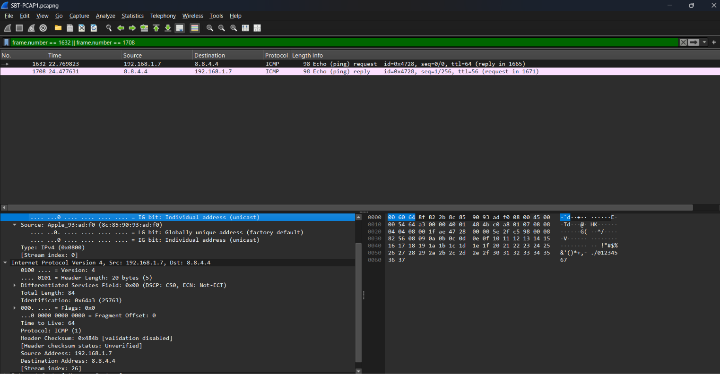
Unusual items: new device and slow ping
DHCP frame 2585 (t = 34.94 s); SSDP frame 2598
Slow ICMP echo, frames 1632 to 1708
Replies from 8.8.4.4 arrive in about 0.58 s and 0.70 s: high latency, but the path works.
Hostname Galaxy-S8 requested 192.168.1.6. An IPv6 router solicitation (frame 2566) at the same moment suggests the same device joined the network.

Slide 11
Event timeline
Time | Frames | Event
0 s | 1 to 6 | Capture starts mid-connection
1.585 s | 52 to 55 | New TLS connection to Google
2 to 4 s | 94 to 128 | DNS retry; late duplicate reply causes ICMP unreachable
9.2 s | 580 | ARP refresh by the gateway
15.7 s | 998 | SSDP and mDNS discovery from 192.168.1.8
22.8 s | 1632 | Ping to 8.8.4.4
34.6 to 35.1 s | 2555 to 2603 | Galaxy-S8 joins (IPv6, DHCP, SSDP)
47.9 to 48.7 s | 3574 to 3775 | HTTP to Mozilla, 301 redirect to HTTPS
68.6 to 75.2 s | 5316 to 5941 | Avast update HTTP requests

